Slide 1

Practical implementation of the GSBPM for regular LFS
Series of webinars on Strategies to calculate LFS sample weights using Calibration.
4-13 March 2025
Antonio R. DISCENZA
Senior Labour Statistician - ILO Department of Statistics - discenza@ilo.org

Slide 2
Outline of the session S05
Overview of the GSBPM
Organising folders and subfolders for processing LFS sample data according to the GSBPM
Main source: official documentation and other contributions available at
  https://statswiki.unece.org/display/GSBPM/

Slide 3
Part 1:
Overview of the
Generic Statistical Business Process Model
(GSBPM)

Slide 4
Survey Management
Survey managers and statisticians bring together and optimize the resources necessary to successfully complete projects
They will find much easier to manage the project if the statistical process is well ordered and follows clearly defined steps.
The Generic Statistical Business Process Model (GSBPM)
  Is a framework that, among other uses, can help project managers and statisticians to plan, manage and carry out statistical projects
    new statistical projects,
    revision of existing project
4

Slide 5
The Business Process
What is a “Business Process”?
Is a collection of related, structured activities, actions, tasks or operations that produce a specific service or product for particular customers or users.
What is a “Business Process Model”?
is the analytical representation / illustration of the activities which explain the way we need to do things in order to get the service or product
Why Generic?
Relating to a class or groups of activities - not specific (in our case: surveys, censuses, statistical use of administrative data, statistical registers, back-recalculation, etc.)

Slide 6
GSBPM: Background and overview 1/2
The GSBPM has been developed under the auspices of UNECE in cooperation with Eurostat, OECD and several of the most advanced NSOs
The first version was released in March 2008
The current version, GSBPM 5.1, has been released in January 2019

Slide 7
Structure of the GSBPM
The GSBPM comprises three levels that represents the whole statistical production process :
Level 0, the statistical business process
Level 1, the eight phases of the statistical business process
Level 2, the individual sub-processes within each phase
Further levels may be added in certain processes or in national-specific implementations, when a sub-process is composed of several components (tasks or activities).

Slide 8
Main phases of the GSBPM
The GSBPM lists 8 main phases
PLANNING
PRODUCTION
1
Specify Needs
2
Design
3
Build
4
Collect
5
Process
6
Analyse
7
Disseminate
8
Evaluate
EVALUATION
Each phase is divided into several sub-processes, listed in a (general) logical order, from what we need to focus on first, to the end of each phase
We need to specify the content of each of these sub-processes
  Then, we need to observe, follow and respect them

Slide 9
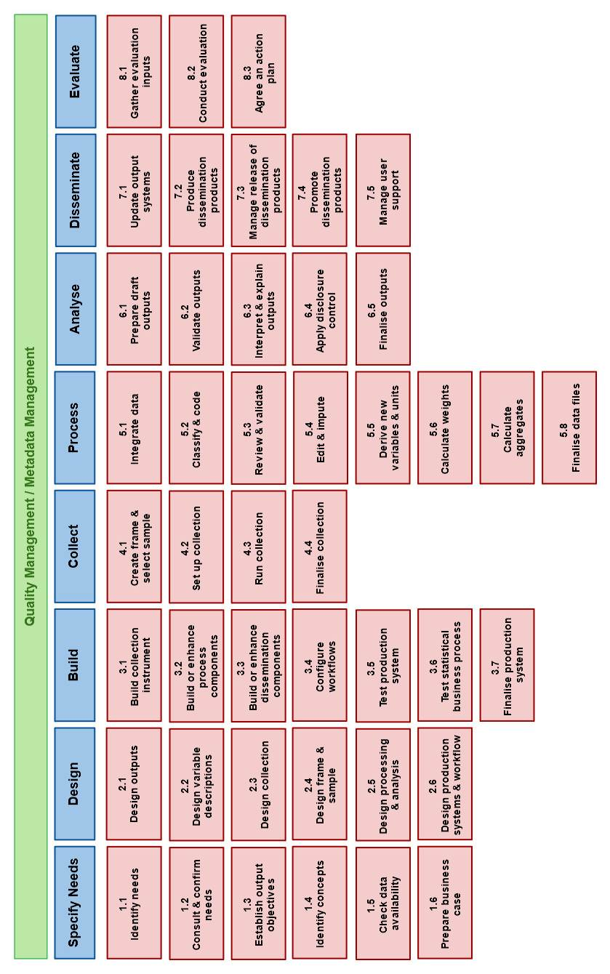
GSBPM version 5.0: Level 1 and 2

Slide 10
GSBPM version 5.0: Level 1 and 2
General order of the
statistical production phases
General order of the
sub-processes

Slide 11
GSBPM version 5.0: Level 1 and 2

Slide 12
GSBPM: Over-arching processes
GSMPM includes several over-arching processes
  Encompasses all phases and sub-processes
The following two can be considered crucial:
Data and Metadata Management (Archiving)
  Preserve/Dispose statistical micro-data and indicators (secondary data/paradata) available in all phases
  Preserve/Update/Dispose associated metadata that describe data and processes and drives actions.
Quality Management
  Refers to the quality of the overall product and process

Slide 13
GSBPM: Background and overview 2/2 pe of the GSBPM
Originally intended
  to provide the basis for statistical organisations to agree on standard / harmonized terminology to aid their discussions on developing statistical metadata systems and processes
  Now widely adopted and recognized as a flexible tool to provide a standard framework to help statistical organisations:
  to define and describe the set of business processes needed to produce official statistics
  to share developed methods and components
  to get a standard-based modernisation of their statistical production processes

Slide 14
Understanding the GSBPM 1/2
GSBPM follows the (general) logical sequence of steps needed in most statistical business processes.
However, it is not a rigid framework in which all steps must be followed in a strict order. It should be applied and interpreted flexibly.
GSBPM should therefore be seen more as a matrix, through which there are many possible not linear paths.
In this way it aims to be sufficiently generic and flexible to be widely applicable in many scenarios

Slide 15
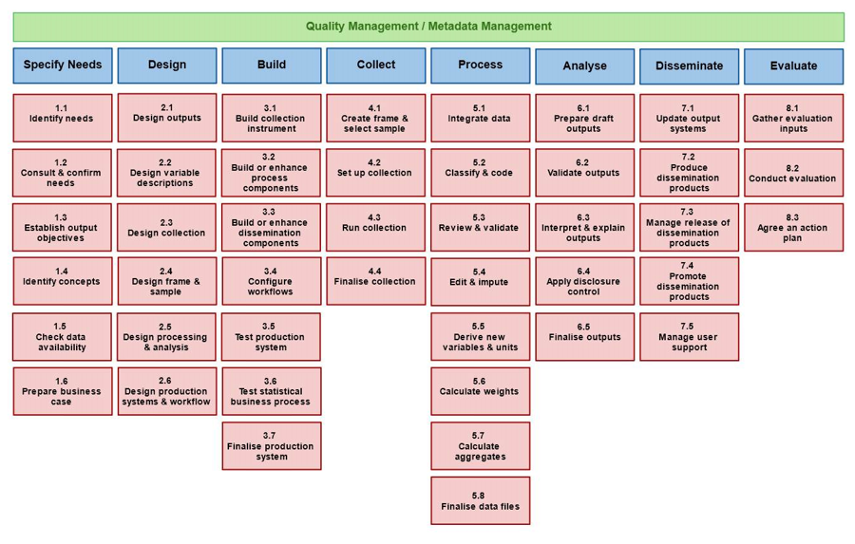
Understanding the GSBPM 2/2
In different circumstances sub-processes
may occur in different orders
may be revisited a number of times forming iterative loops (e.g. Process and Analyse )
may be skipped (e.g. in regular processes/iterations)

Slide 16
Why statistical offices (we) need a business process model ? 1/2
To develop a structured approach for organisation of the statistical production processes in a logical manner from beginning to end
To help us think about the statistical production as a coherent process made of a sequence of activities and steps
To ensure that we think through the whole statistical production in a disciplined manner,
  It encourages to better organize our work …
  … does not allow messy work
  It ensures we do not forget / skip anything

Slide 17
Why statistical offices (we) need a business process model ? 2/2
  Use of the same standardized processes in different subjects areas (e.g. data capturing, weighting, coding, tables for dissemination, etc.)
  Defining, describing and mapping processes in a coherent way
and, most important, it contributes
  to enhance overall efficiency
  to enhance overall quality

Slide 18
First implementation of GSBPM: where to start from
Initially, it is not necessary that the model is adopted for all subjects, all surveys and all processes.
Best to apply a gradual approach,
  select some specific tasks,
  select existing surveys / data collections / processes that need an overhaul and renewal,
  or, start by applying the model only for new surveys
The model is flexible – we can decide where to start, what to skip and what need more focus
but
Set precise rules for Data Management
Prepare detailed Metadata, they are crucial because describe data and drive processes and actions

Slide 19
GSBPM cornerstone for modernisation
The GSBPM facilitates and encourages standardization of processes, methods, procedures, applications, templates, tools, questionnaires etc.
  Use of the same standardized processes in different subjects areas (e.g. data capturing, weighting, coding, tables for dissemination, etc.)
  Defining, describing and mapping processes in a coherent way
  Clearly defining the boundaries between sub-process and the inputs and outputs of each of them
The use of standardized instruments across the institution
  reduces risks, costs and time
  facilitates more uniform training within the organization
  allows for increased mobility within the institution across sectors
  enhance overall quality and efficiency

Slide 20
Part 2:
Getting the production phases organized according to the GSBPM
(for a labour force survey with regular survey rounds)

Slide 21
Production phase
The production phase revolves around 4 phases and 22 sub-process,
are generally sequential,
can be done in different orders in different circumstances
They have many inter-dependencies
can also occur in parallel,
and can be iterative

Slide 22
From theory to practice 1/3
While the theoretical framework and the advantages of the GSBPM are very clear …
… the way to set up procedures and to store data and metadata on computers or servers might not be always straightforward.
  Our aim is to carry out the many and diverse activities of the statistical process in an orderly and disciplined manner, following the GSBPM.
  Therefore, also the organization of folders/sub-folders, documents, data and procedure/programs could follow the same approach.

Slide 23
From theory to practice 2/3
One of the challenges for many NSOs is to get the different components of a statistical process well organized, especially when surveys are carried out on periodic or regular bases.
  There are many possible ways to organize data, programs, metadata, documents, indicators, etc,
    Some very advanced from the IT point of view,
    Others less advanced, but anyway very efficient and effective, especially for countries with few resources and that cannot invest in more advanced IT systems

Slide 24
A simple way to get all the components organized
The solution presented below is only one of the many possible ways to organize the different components. It takes into account:
  The main objective – and the related advantages - of re-using most of the standardised procedures – with minor changes – in different survey rounds.
    Examples presented are based on a quarterly LFS. They can be easily adapted to surveys conducted on continuous, monthly, seasonal, and annual bases.
  The programs and procedures for each of the sub-processes can generally be run using any statistical software already available within the NSO (e.g. SPSS, STATA, SAS, R, etc.).
    Different software can be used for different tasks, which increases flexibility of the entire statistical business process.
    To begin, perhaps we do not need to invest in software, but only put an order in the various procedures/programs/data/metadata/outputs that are used for each survey round

Slide 25
Use a common server, computer or a shared disk
One of the first general suggestions is that all the procedures/ programs/ data/ metadata/ and outputs should be all placed on a shared server/computer
  With regular backups
  That can be accessed remotely by all the staff members who are in charge of the different tasks
  A gradual approach is possible,
  Starting with the resources already available in the office
  Planning to move to a better solution in the medium term.
      IT colleagues within the office can probably help to identify the best solution with the resources available.
Sometimes the quick solution could be a simple shared remote drive ( or disk) on a dedicated desktop pc that acts as server. Then the staff can connect to the drive from their own computer to launch the programs/procedures stored on the shared drive and automatically save the results on it as well.

Slide 26
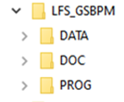
Use a standardised system of folder and sub-folders
On the computer server (or the shared disk) we need to define what we can call the “File Structure”,
  i.e. system of folder and sub-folders that will contain the various procedure, programs, data, metadata, outputs and documentation of the entire statistical process.
Example for a LFS (under Windows operating system)
  the main folder is called “LFS_GSBPM”
  this is only an example, the suffix GSBPM helps us to distinguish it from a LFS folder that could already exist on the server,
  and allows us to keep both old and new folders up until all the processes have moved to the new system

Slide 27
Use a standardised system of folder and sub-folders
  The main folder contains three folders
  DATA - Contains input and output data, as well as output tables and collections of indicators.
  PROG - Contains the programs/procedure for the different sub-processes. These could be based on different software used for different purposes (e.g. specific statistical packages for the data storage, processing and tabulation; specific software for imputation, weighting and anonymization; other software for dissemination of tables and indicators, etc.).
  DOC - Contains the documentation, manuals and metadata regarding the sub-processes needed to complete the entire process.

Slide 28
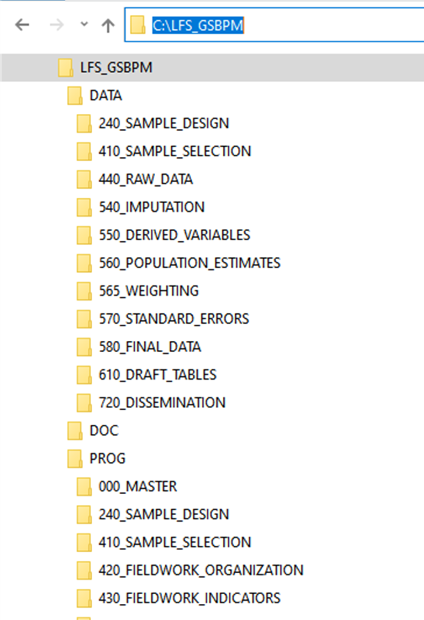
Use a standardised system of folder and sub-folders
  Within each of the three folders we have a series of sub-folders, one for each sub-process actually implemented in the LFS.
  The name of the sub-folder starts with a 3-digit prefix reflecting:
    the GSBPM sub-process code (2-digits), and
    a further digit (by default zero) that can be used to identify further specific sub-processes needed to customize the implementation.
      For example, to calculate weights (sub-process 5.6) we need to:
      First, calculate the figures for the reference population that will be the benchmark for weighting (prefix 5.6.0 in our example)
      Then, benchmark the sample data to the population figures (sub-process 5.6.5 in our example).
      It is also possible that NSO calculates monthly estimates; hence, a specific sub-process could be conveniently added for it

Slide 29
Use a standardised system of folder and sub-folders
  The 3-digit Prefixes
    allow us – and our coworkers - to recognize easily the different sub-process
    Allows to keep the folders and subfolder ordered according to the general logical sequence activities and steps.
  This kind of organization
    helps us thinking through the whole statistical production in a disciplined manner
    ensures we do not forget / skip anything because we can write the programs so that we cannot execute a task if we have not concluded “successfully” the previous one(s).
      E.g. we cannot calculate the derived variables needed to produce the tables for dissemination if we have not concluded the editing and imputation

Slide 30
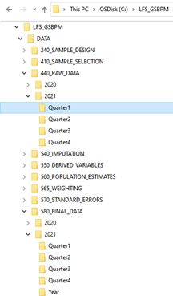
Use a standardised system of folder and sub-folders
  Depending on the periodicity of the survey, within each sub-process we need further folders for the year, quarter and month of reference of the survey round
    Or any kind of other identifier, e.g. Round1, Round2
  For a quarterly labour force survey, we might envisage other folders organized as shown for the sub-processes 440 and 580.

Slide 31
Use standardised names and contents for data files
Generally, we will have several output microdata from the main sub-processes, named in a similar way, but with a suffix indicating the task they are the result of. For example: in case the SPSS is used:
FILENAME | FOLDER | CONTENTS
LFS_2021_Q2_RAW.sav | ..DATA\440_RAW_DATA\2021\Quarter2 | Raw data received from the data collection team
LFS_2021_Q2_FMTD.sav | ..\DATA\520_CODING\2021\Quarter2 | Variables whose names and formats have been harmonized/standardized
LFS_2021_Q2_CHECK.sav | ..DATA\ 530_CHECKING\2021\Quarter2 | Result of validation, indicating which record and variable need to be imputed
LFS_2021_Q2_CLEAN.sav | .. DATA\540_IMPUTATION\2021\Quarter2 | Containing the data cleaned and imputed
LFS_2021_Q2_DER.sav | ..DATA\550_DERIVED_VARIABLES\2021\Quarter2 | Clean data to which the derived variables for analysis and dissemination have been added
LFS_2021_Q2_WEIGHTS.sav | .. DATA\565_WEIGHTING\2021\Quarter2 | Containing the design, intermediate and final weights for the microdata of the quarter
LFS_2021_Q2_FIN.sav | .. DATA\580_FINAL_DATA\2021\Quarter2 | Result of a merge between the clean data with the derived variables (DER dataset) and the final weights (WEIGHTS)
LFS_2021_Q2_TAB.sav | ..DATA\610_DRAFT_TABLES\2021\Quarter2 | Containing final data standardized across quarters (in case the FIN data are not yet standardized). To be used for standard tables and feed information systems
Variables in the datasets should have standard names, formats and classifications in order to facilitate the use of standard programs/syntax (a metadata system would document this aspect).

Slide 32
Use standardised and re-usable program files
Programs and procedure could be based on different software used for different purposes in different sub-processes.
In many cases, programs and procedures can be “generic”, hence re-usable without any major change for different survey rounds – by simply changing a few external parameters, such as the year and the quarter of the survey round.
  This is usually the case for the calculation of fieldwork indicators, calculation of standardized derived variables (when the questionnaire does not change across quarters), preparation of inputs for the weighting procedure, production of standard tables, upload of information systems and websites, etc.
Most of the statistical software more commonly used allow some kind of parameterisation of programs (syntaxes) using either macros or macro variables
  to parameterize year, quarter, filenames, folders, etc.

Slide 33
Parameterisation of program files
The use of macro parameters in programs can really increase efficiency of the process and reduce burden on staff.
For examples: Instead of writing codes like (using STATA syntax)
SAVE “C:\LFS_GSBPM_DATA\580_FINAL_DATA\2021\Quarter2\LFS_2021_Q2_FIN.dta“
We could write something more generic
GLOBAL par_year = 2021
GLOBAL par_quarter = 2
  SAVE “C:\LFS_GSBPM\DATA\580_FINAL_DATA\” + par_year + “\Quarter” + par_quarter + ”\LFS_”
  + par_year + ”_Q ” + par_quarter + ”_FIN.dta”
  Moreover, the parameterisation of “file names”, “folder names” and “paths” makes sure that the inputs and output are retrieved from - and saved in - the right folders.
    This makes future changes to the file structure more manageable (e.g. move the main folder to another drive)
We assign a specific value to the parameters

Slide 34
Use standardised and re-usable program files
Different software have different level of complexity in using parameters, macros and macro variables, hence a certain level of training/learning is required to develop such kind of “parameterized” programs.
When the parameterization of programs results too difficult, programs have to be specific for each survey round and need to be placed in the PROG folder of the corresponding sub-process and survey round.
  To re-use these programs in future rounds, it would be possible to make a copy of them and change manually (within them) the parameters that identify the survey round.
    Suggestion: we should write programs that allow to use the function “find and substitute” to change the parameters altogether within the program files (we do not want to risk to omit some of them).
For some sub-processes, programs need to be always “specific” of the survey “round”, as for editing, probabilistic/deterministic imputation, and validation
  given that the type of errors and/or the records affected may well be different

Slide 35
Use of program files for data processing
It is always recommended that any change to be made on the microdata is made via specific instructions in a program file
  E.g. syntax files SPSS; do files STATA; program file SAS; script files R, Python Notebooks , etc.
  Changes to variable formats, missing value imputation, calculation of derived variables, merge of datasets, import and export of data, etc.
The use of program files have many advantages, among which:
  Possibility to replicate tasks in case of errors, loss or damage to the data (data that are over-written, wrong merge/match that corrupts data, etc. )
  Possibility to re-use the program files (as is or with minor changes) to replicate the same tasks on data from different survey rounds (or on different surveys)
  Document the operations made on the data (e.g. imputation of data), hence allow to trace back possible errors, fix them and quickly re-execute the task
  Put comments in the programs on how to run some tasks, e.g. what to check in the outputs
  Add code to move, copy, rename and zip files
  Sometimes, program the visualization of pop-up messages that provide guidance on next step

Slide 36
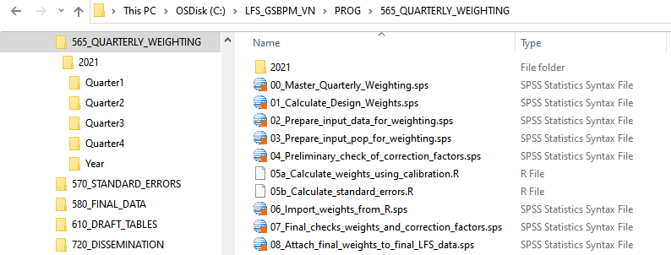
Use of program files for data processing
  In same cases, names of program files can be written in a way that help users to document the actual sequence of the operations, hence help to run the tasks with the planned sequence reducing the risk to forget/omit some tasks.
  As an example, the following figure shows the sequence of programs used to calculate the final weights. They have a prefix from 01 to 08 so that they appear in the exact order they have to be executed, which greatly simplify the overall task.

Slide 37
THANK YOU FOR YOUR ATTENTION!
Any questions?

